Slide 1


High Performance Cluster Computing
Architectures and Systems
Hai Jin
Internet and Cluster Computing Center

Slide 2
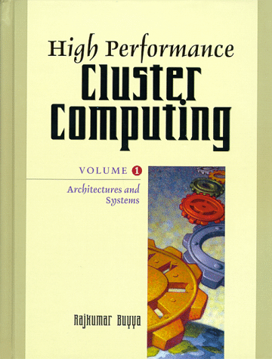
Network RAM
  Introduction
  Remote Memory Paging
  Network Memory File Systems
  Applications of Network RAM in Database
  Summary

Slide 3
Introduction (I)
Discuss efficient distribution & exploitation of main memory in a cluster
Network RAM or Network Memory
  the aggregate main memory of the workstation in a cluster
  local memory vs. remote memory
A significant amount of resources unused in the cluster at any given time
  80-90% of workstation will be idle in the evening & late afternoon
  1/3 of workstations are completely unused, even at the busiest times of day
  70-85% of the Network RAM in a cluster is idle
Consist of volatile memory
  but still can offer good reliability
    use some form of redundancy, such as replication of data or parity
  offer an excellent cost-effective alternative to magnetic disk storage

Slide 4
Introduction (II)
Technology trend
  High performance networks
    switched high performance local area network : ex) myrinet
    low latency communication and messaging protocols : ex) U-Net
      latency of Active Message on ATM (20 μs) vs. magnetic disk latency (10ms)
  High performance workstations
    memories with low cost
      Network RAM even more attractive
  The I/O processor performance gap
    the performance improvement rate for
      microprocessor: 50-100% per year
      disk latency: 10% per year
      network latency: 20% per year
      network bandwidth: 45% per year

Slide 5
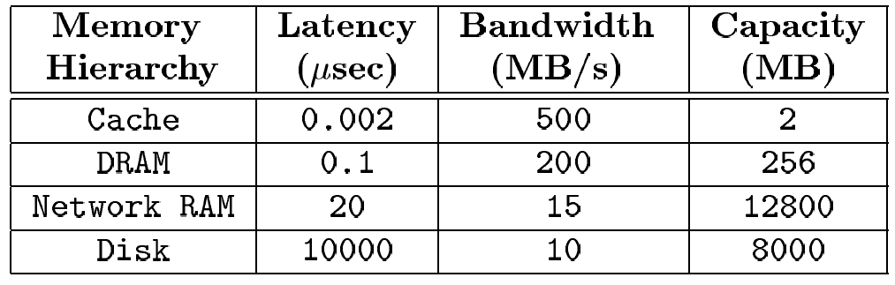
Memory Hierarchy Figures for a Typical Workstation Cluster
A typical NOW with 100 workstations
A network of 20 μs latency & 15 MB/s bandwidth

Slide 6
Introduction (III)
Issues in Using Network RAM
  Using network RAM consists essentially of locating & managing effectively unused memory resources in a workstation cluster
    keeps up-to-date information about unused memory
    exploit memory in a transparent way so that local users will not notice any performance degradation
    require the cooperation of several different systems
  Common use of Network RAM
    Remote memory paging
      performance: between the local RAM and the disk
    Network memory filesystems
      can be used to store temporary data
        by providing Network RAM with a filesystem abstraction
    Network memory DBs
      can be used as a large DB cache and/or a fast non-volatile data buffer to store DB sensitive data

Slide 7
Remote Memory Paging (I)
64-bit address space
  heavy memory usage
  application’s working sets have increased dramatically
    sophisticated GUI, multimedia, AI, VLSI design tools, DB and transaction processing systems
Network RAM
  equivalent of remote memory paging
  (cache) – (main memory) – (network RAM) – (disk)
  faster than the disk
  all memory-intensive applications could benefit from Network RAM
  useful for mobile or portable computers, where storage space is limited

Slide 8
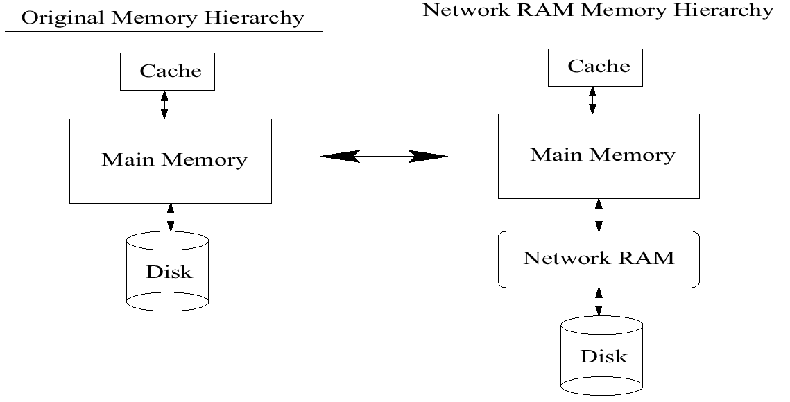
Changing the Memory Hierarchy

Slide 9
Remote Memory Paging (II)
Implementation Alternatives
  Main idea of remote memory paging
    start memory server processes on workstations that are either idle or lightly loaded and have sufficient amount of unused physical memory
  A policy for the page management
    which local pages?
    which remote nodes?
      client periodically asks the global resource manager
      distribute the pages equally among the servers
    how server load?
      negotiation from server to client & migration
      transfer data to server’s disk

Slide 10
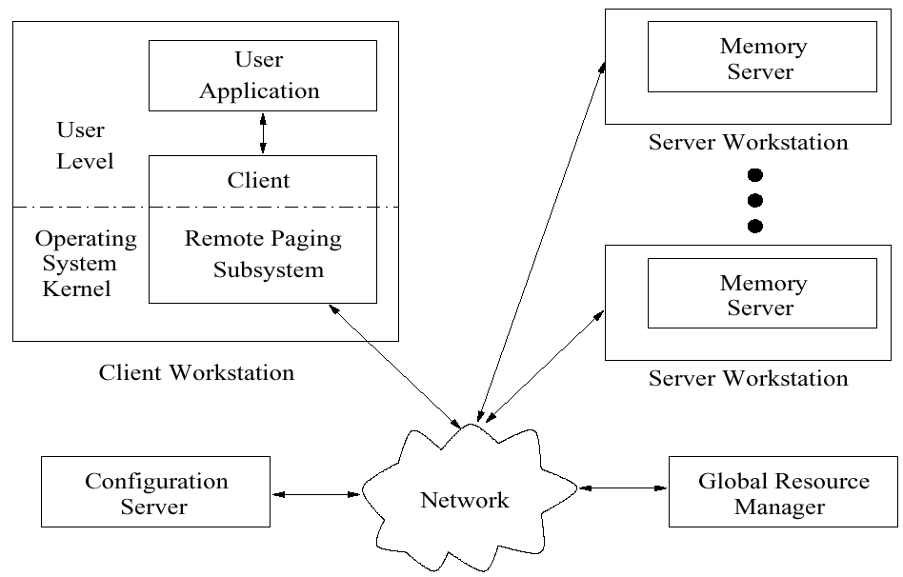
Remote Paging System Structure

Slide 11
Remote Memory Paging (III)
Implementation Alternatives
  the client workstation has a remote paging subsystem
    user-level
    in the OS
      enable it to use network memory as backing store
  a global resource management process
    running on a workstation in the cluster
    hold information about the memory resources & how they are being utilized in the cluster
  a configuration server (registry server) process
    responsible for the setup of the network memory cluster
    is contacted when a machine wants to enter or leave the cluster
    authenticated according to the system administrator’s rules

Slide 12
Remote Memory Paging (IV)
Client remote paging subsystem
  2 main components
    a mechanism for intercepting & handling page faults
    a page management policy
      keep track of which local pages are stored on which remote nodes
  2 alternative implementations of transparent remote paging subsystem on the client workstation
    using the mechanisms provided by the existing client’s OS
    by modifying the virtual memory manager & its mechanisms in the client’s OS kernel

Slide 13
Transparent Network RAM Implementation using Existing OS Mechanisms (I)
User Level Memory Management
  each program uses new memory allocation & management calls, which are usually contained in a library dynamically or statically linked to the user applications
  require some program code modifications
  prototype by E. Anderson
    a custom malloc library
    using TCP/IP, perform a 4K page replacement in 1.5 – 8.0 ms (1.3 – 6.6 faster)
  mechanism
    intercept page faults through the use of segmentation faults
    a segmentation fault signal from OS memory manager
    this signal intercepted by the user level signal handler routines
    page management algorithm is called to locate & transfer a remote page into local memory, replacing a local page

Slide 14
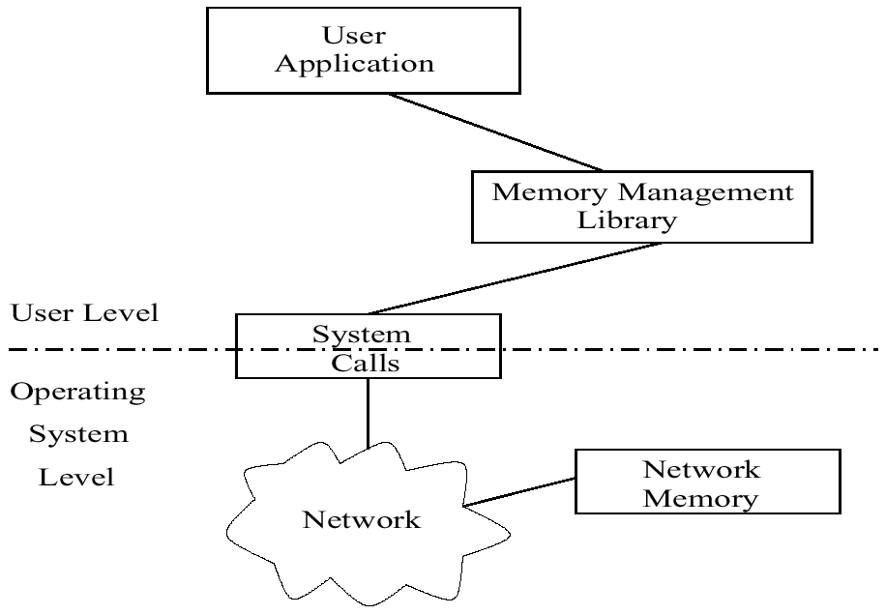
User Level Memory Management Solution’s Structure

Slide 15
Transparent Network RAM Implementation using Existing OS Mechanisms (II)
Swap Device Driver
  the OS level implementation
  all modern operating system provide virtual memory manager which swap pages to the first device on the list of swap devices which will be the remote memory paging device drivers
  create a custom block device & configure the virtual memory manager to use it for physical memory backing store
    when run out of physical memory, it will swap pages to the first device on the list (may be the remote memory paging device driver)
    if and when this Network RAM device runs out of space, the virtual memory manager will swap pages to the next device
  simple in concept & require one minor modification to the OS
    the addition of a device driver

Slide 16
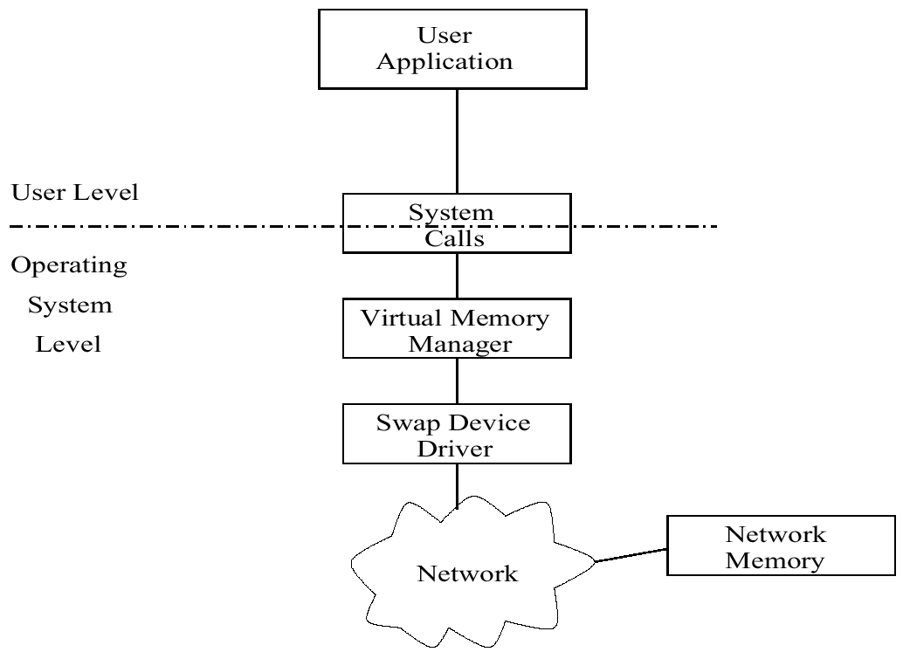
Swap Device Driver Solution’s Structure

Slide 17
Transparent Network RAM Implementation using Existing OS Mechanisms (III)
Page Management Policies
  which memory server should the client select each time to send pages
    global resource management process
    distribute the pages equally among the servers
  handling of a server’s pages when its workstation becomes loaded
    inform the client & the other servers of its loaded state
    transfer them to the server’s disk & deallocate them each time they are referenced
    transfer all the pages back to the client
  when all servers are full
    store the pages on disk

Slide 18
Transparent Network RAM Implementation Through OS Kernel Modification (I)
OS modification
  software solution offers the highest performance without modifying user program
  an arduous task
  not portable between architectures
Kernel modification
  provide global memory management in a workstation cluster
  using a single unified memory manager as low-level component of OS that runs on each workstation
  can integrate all the Network RAM for use by all higher-level functions, including virtual memory paging, memory mapped files and filesystem caching

Slide 19
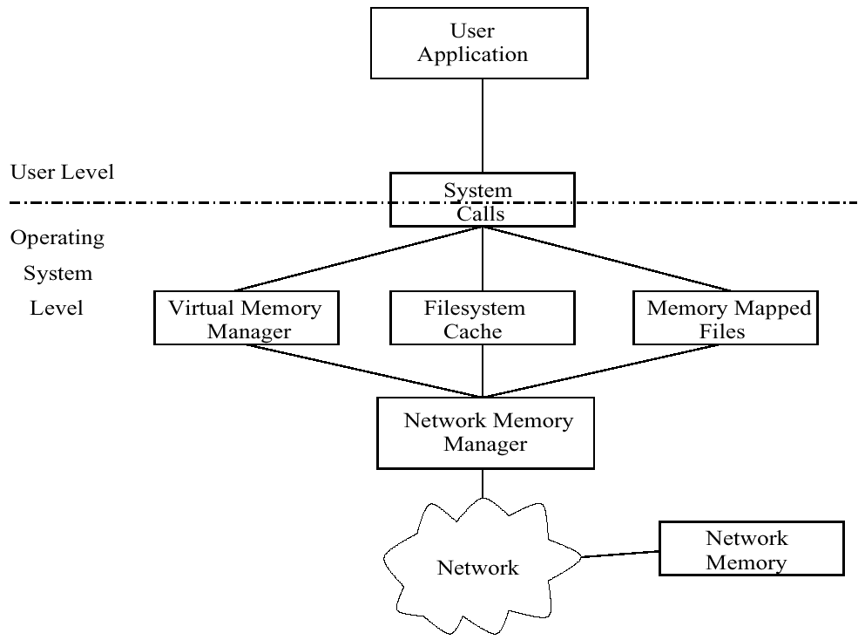
Operating System Modification Architecture

Slide 20
Transparent Network RAM Implementation Through OS Kernel Modification (II)
Global memory management
  Page fault in node P in GMS
    the faulted page is in the global memory of another node Q
    the faulted page is in the global memory nodes of node Q, but P’s memory contains only local pages
    the page is on disk
    the faulted page is a shared page in the local memory of another node Q

Slide 21
Boosting Performance with Subpages
Subpages are transferred over the network much faster than whole pages
  not with magnetic disk transfers
Using subpages allow a large window for the overlap of computation with communication

Slide 22
Reliability (I)
Main disadvantages of remote memory paging
  security: can be resolved through the use of a registry
  reliability (fault-tolerant)
Use a reliable device
  the simplest reliability policy
  reliable device such as the disk
    async write but, bandwidth limited
    can achieve high availability but simple
    performance under failure
    disk memory overhead (expensive)
Replication – mirroring
  using page replication to remote memory without using disk
  (-) use a lot of memory space, high network overhead

Slide 23
Reliability (II)
Simple parity
  extensively used in RAIDs, based on XOR operation
  reduce memory requirement (1+1/S)
  network bandwidth & computation overhead
  if two servers have failure???
Parity logging
  reduce the network overhead close to (1 + 1/S)
  difficult problems from page overwriting

Slide 24
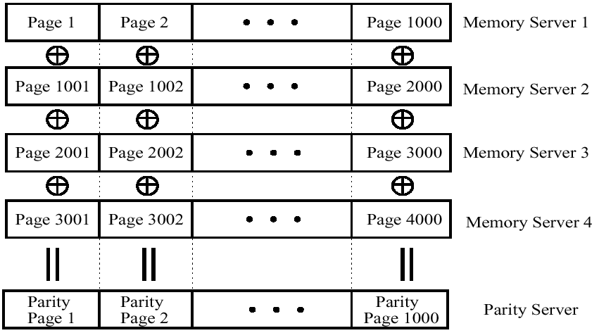
An Example of the Simple Parity Policy (Each server in this example can store 1000 pages)

Slide 25
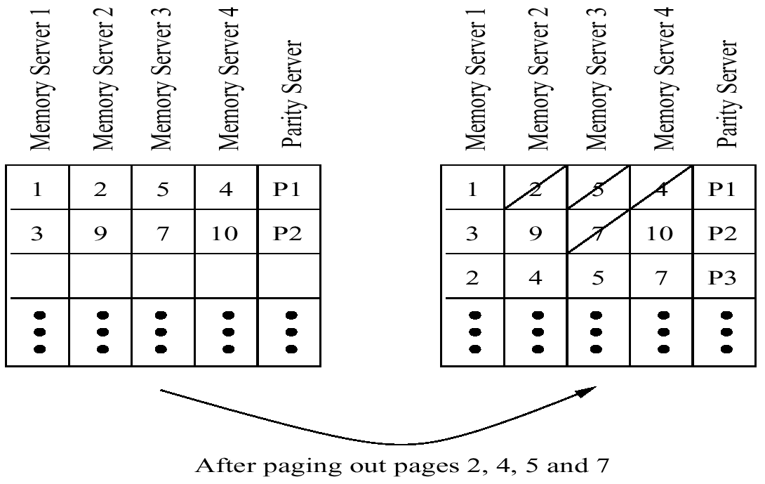
A Parity Logging Example with Four Memory Servers and One Parity Server

Slide 26
Remote Paging Prototypes (I)
The Global Memory Service (GMS)
  A modified kernel solution for using Network RAM as a paging device
  (reliability) Write data asynchronously to disk
  The prototype was implemented on the DEC OSF/1 OS
    under real application workloads, show speedups of 1.5 to 3.5
    respond effectively to load changes
  Generally very efficient system for remote memory paging

Slide 27
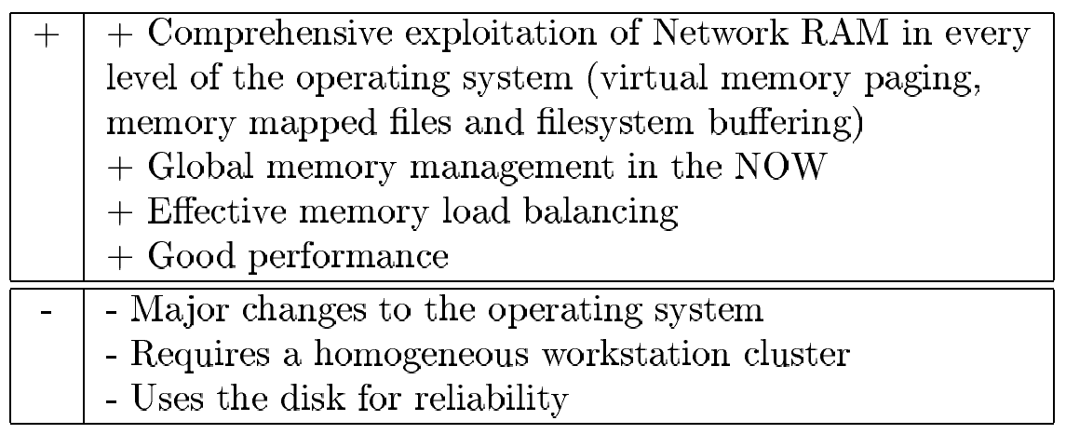
Pros and Cons of GMS

Slide 28
Remote Paging Prototypes (II)
The Remote Memory Pager
  use the swap device driver approach
  the prototype was implemented on the DEC OSF/1 v3.2 OS
  consist of a swap device driver on the client machine & a user-level memory server program runs on the servers
  effective remote paging system
    no need to modify the OS

Slide 29
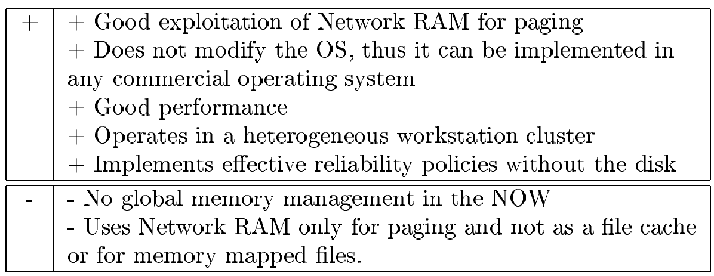
Pros and Cons of the Remote Memory Pager

Slide 30
Network Memory File System (I)
Use the Network RAM as a filesystem cache, or directly as a faster-than-disk storage device for file I/O
Using Network Memory as a File Cache
  all filesystem use a portion of the workstation’s memory as a filesystem cache
  two problem
    multiple cached copies waste local memory
    no knowledge of the file’s existence
  several ways to improve the filesystem’s caching performance
    eliminate the multiple cached copies
    create a global network memory filesystem cache
      ‘cooperate caching’

Slide 31
Network Memory File System (II)
Network RamDisks
  Disk’s I/O performance problem
  Use reliable network memory for directly storing temporary files
  Similar to Remote Memory Paging
  Can be easily implemented without modifying OS (Device Driver)
  Can be accessed by any filesystem (NFS)
  Network RamDisks
    a block device that unifies all the idle main memories in a NOW under a disk interface
    behaves like any normal disk, but implemented in main memory (RAM)
    (diff)
      instead of memory pages, send disk blocks to remote memory
      disk blocks are much smaller than memory pages (512 or 1024 bytes) and on many OSs variable in size (from 512 bytes to 8 Kbytes)

Slide 32
Applications of Network RAM in Databases (I)
Transaction-Based Systems
  to substitute the disk accesses with Network RAM accesses
    reducing the latency of a transaction
  a transaction during its execution makes a number of disk accesses to read its data, makes some designated calculations on that data, writes its results to the disk and, at the end, commits
    atomicity & recoverability
  2 main areas where Network RAM can be used to boost a transactions-based system’s performance
    at the initial phase of a transaction when read requests from the disk are performed
      through the use of global filesystem cache
    speed up synchronous write operations to reliable storage at transaction commit time
      transaction-based systems make many small synchronous writes to stable storage

Slide 33
Applications of Network RAM in Databases (II)
Transaction-Based Systems
  Steps performed in a transaction-based system that uses Network RAM
    at transaction commit time, the data are synchronously written to remote main memory
    concurrently, the same data are asynchronously sent to the disk
    the data have been safely written to the disk
  In the modified transaction-based system
    a transaction commits after the second step
    replicate the data in the main memories of 2 workstations
  Results
    the use of Network RAM can deliver up to 2 orders of magnitude higher performance

Slide 34
Summary
Emergence of high speed interconnection network added a new layer in memory hierarchy (Network RAM)
Boost the performance of applications
  remote memory paging
  file system & database
Conclusion
  Using Network RAM results in significant performance improvement
  Integrating Network RAM in existing systems is easy
    device driver, loadable filesystem, user-level code
  The benefits of Network RAM will probably increase with time
    gap between memory and disk continue to be widen
Future Trend
  Reliability & Filesystem Interface

